Slide 1
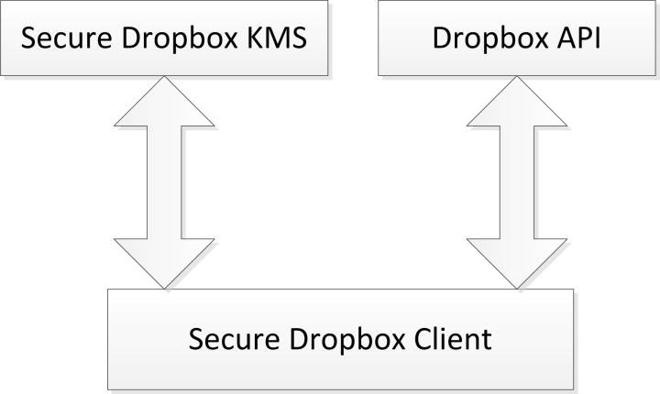
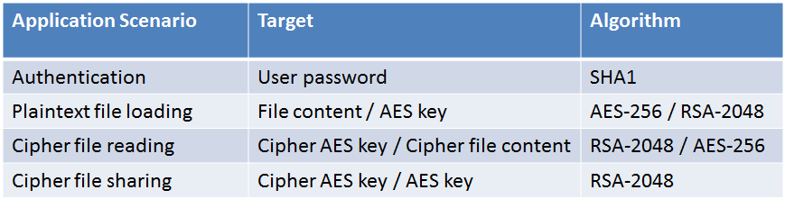
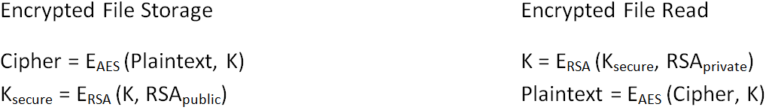
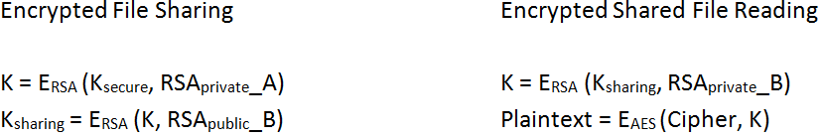


Secure Dropbox
Juntao Gu. Supervisor: Hitesh Tewari
Introduction
Implementation
Current storage systems secure data either via encrypting data on the wire, or through data encryption on the physical disk. Cryptographic protection of single file instances could prevent data modification or leakage during storage.
The goal of the Secure Dropbox is to investigate the feasibility of gaining users’ confidence towards the security of cloud storage service by utilization of a hybrid encryption mechanism in terms of data security and key management.
Secure Dropbox is designed as a client end encryption tool over the Dropbox service. The main idea is to provide a file encryption service with symmetric cryptography where key is not known to Dropbox and ciphered with asymmetric cryptography for sharing encrypted file.
Secure Dropbox Architecture
Secure Dropbox performs file operations like uploading, downloading and sharing via Dropbox Core API and Dropbox application. It performs cryptographic computations in the local host.
Key Management Service (KMS) mainly processes key management requests and storage requests. No cryptographic computation involves in KMS.
Design
Encrypted File Storage
Cryptography Application in Secure Dropbox
In the file encrypted storage procedure, plain text is ciphered in AES with a random generated file encryption key. Then the file encryption key is ciphered in RSA with file owner’s RSA public key as K_{secure}.
In encrypted file reading procedure, firstly the ciphered K_{secure} should be deciphered in RSA with file owner’s RSA private key. After retrieving the raw file encryption key K, the cipher text could be decrypted in AES.
Conclusion
Secure Dropbox accomplishes a client end encryption tool and the key ideas in accordance with security have been explained.
Security of data in Secure Dropbox is based on strength of symmetric cryptography and key management with asymmetric cryptography.
It gains users’ confidence when using public cloud storage service to store their confidential documentations according to the user testing feedback.
Encrypted File Sharing
A wants to share an encrypted file with B. In order to enable B to decipher the key ciphered by A, A should encrypt the raw doc key K in RSA with Bob’s RSA public key. K_{sharing} is generated and then transmitted to Bob via secure tunnels.
After receiving the K_{sharing}, B will decrypt it in RSA with his own RSA private key and then get the raw doc key. Now the plain text of the shared encrypted file could be retrieved by decrypting in AES with the raw doc key.
M.Sc. in Computer Science
(Mobile and Ubiquitous Computing)
Contact Information
Email: juntao.gu@gmail.com
Mobile:083 1675390

